Slide 1

PARK SPOT DETECTION- REAL TIME SMART CAR PARKING WITH AI EYES
BATCH MEMBERS
AJI KUMAR P.S [961820205006]
RAHUL A.S [961820205021]
Final Year | Information Technology
Ponjesly College of Engineering
GUIDED BY
Mrs. Maria Sheeba M
Head of the Department, Information Technology
Ponjesly College Of Engineering

Slide 2

OBJECTIVE
To develop a precise and user-friendly AI-enabled smart car parking detection system using OpenCV, ensuring real-time information on parking space availability for optimal resource utilization and a seamless user experience.

Slide 3

ABSTRACT
Develop an real time AI-powered smart car parking detection system using OpenCV.
Built using HTML, CSS, JavaScript for frontend and supports with Python-django backend with sqlite3 database.
Prioritizes accurate car detection by combining CNN and other advanced machine learning techniques.
User-friendly interface with simplicity and elegance, ensuring a seamless experience for users.
Built to work in busy malls to park a car in a efficient manner.

Slide 4
EXISTING SYSTEM
Manual monitoring or outdated technologies are commonly used in urban parking management.
Use OpenCV for basic image processing tasks like resizing and filtering.
Some parking facilities utilize sensors embedded in parking spaces to detect the presence of vehicles and monitor occupancy.
Barrier gates and ticketing systems are used for entry and exit control in parking lots, often integrated with payment processing systems.
In existing system, the objects were pre trained and used for the parking lots.

Slide 5
PROPOSED SYSTEM
Develop a user-friendly web interface using HTML, CSS, and JavaScript for seamless user experience.
OpenCV, utilized for image processing tasks such as car detection, resizing, filtering, and feature extraction.
Integrating IP Webcam for live camera feed access enhances real-time parking spot detection.
Python Django Framework for backend development and SQLite Database for data storage.
Implement robust security measures with secure authentication, authorization, and HTTPS.

Slide 6











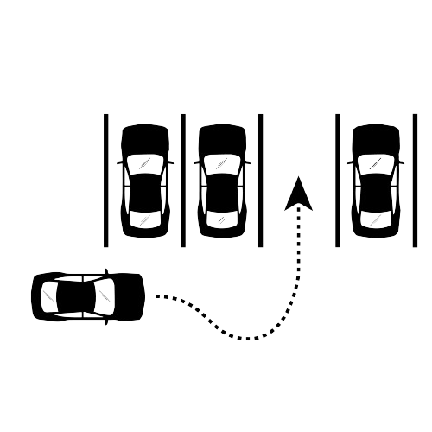


SYSTEM ARCHITECTURE
Checking credentials
IP Web Cam Access
USER
Contact
User Interface
Forgot Password
Parking Button
Maintains data
Django + SQLite
Parking Area

Slide 7
MODULES
Login Module
UI/UX Module
Car Detection Module
User feedback and Reporting Module

Slide 8
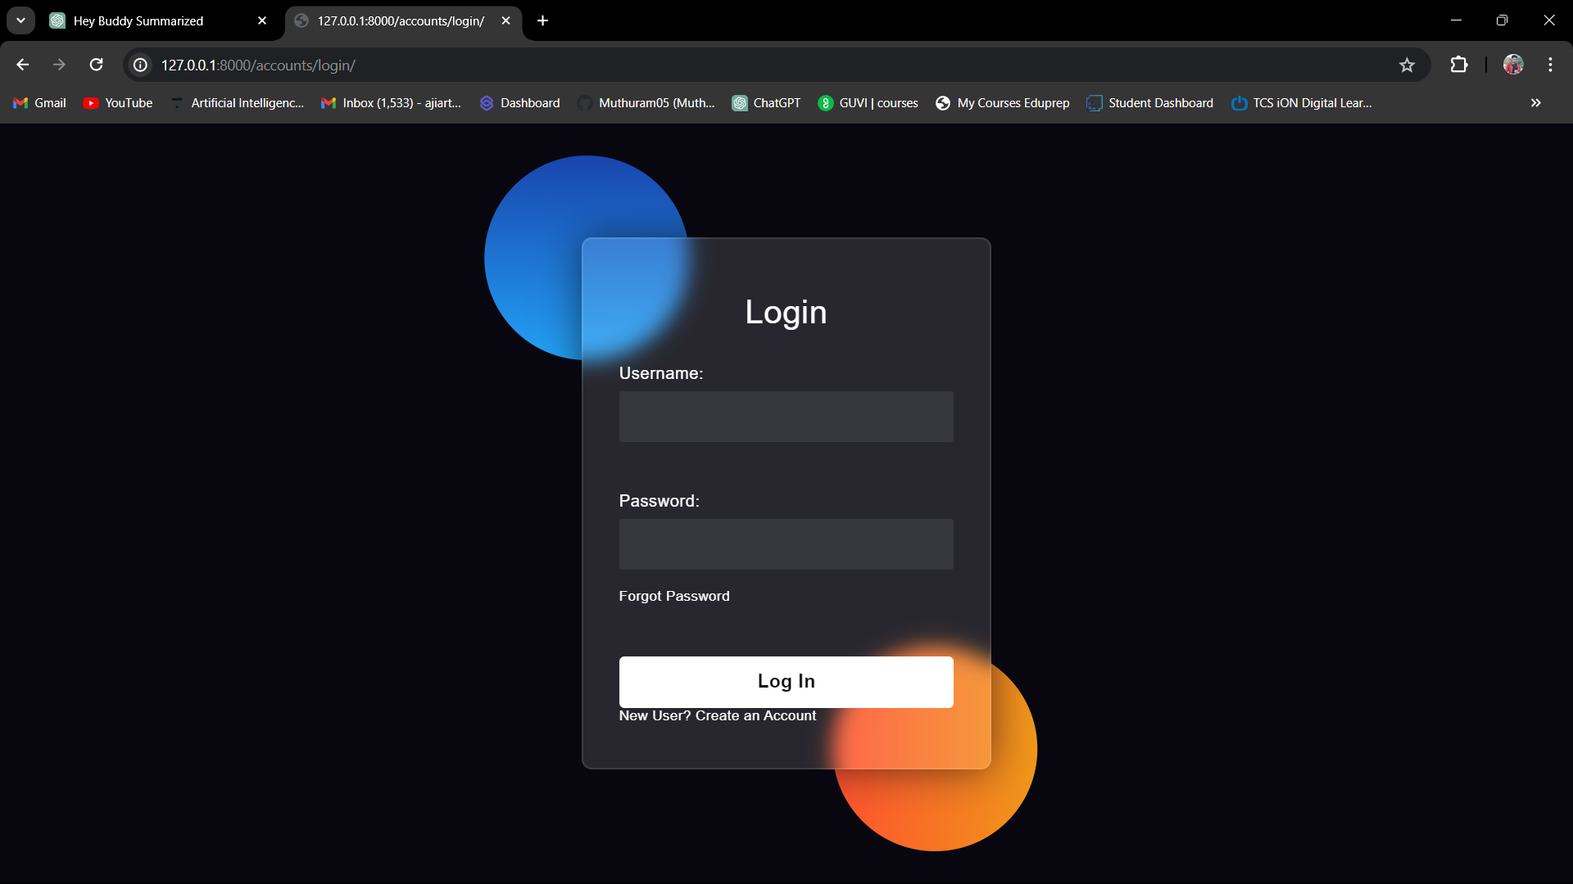
LOGIN MODULE
Enable secure access and authentication for users, ensuring controlled entry into the parking system.

Slide 9
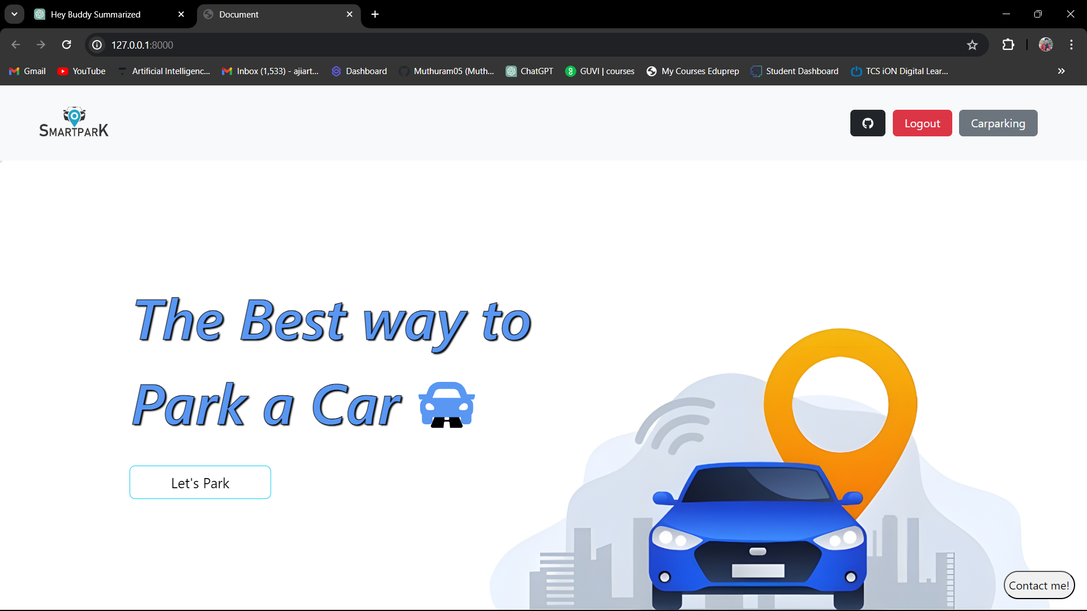
UI/UX MODULE
Deliver intuitive interfaces and seamless navigation, enhancing user interaction and satisfaction.

Slide 10
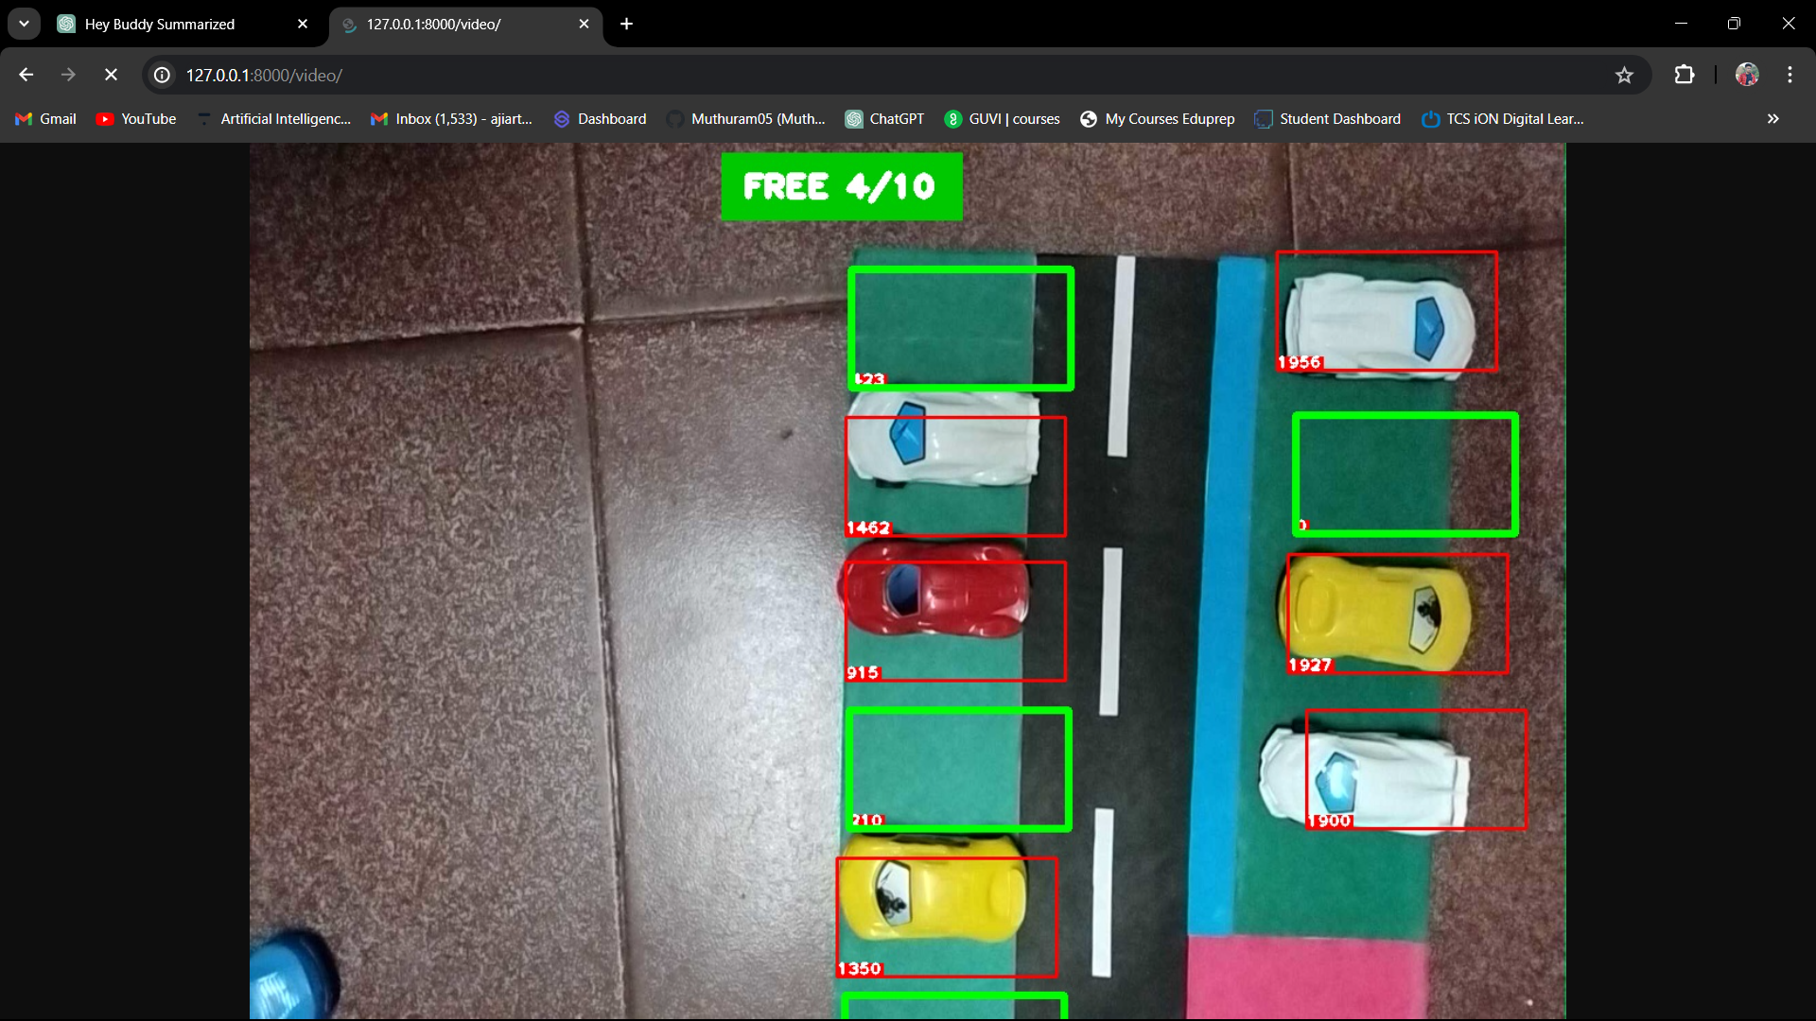
CAR DETECTION MODULE
Utilize OpenCV for real-time detection of parking spots, optimizing space utilization.

Slide 11
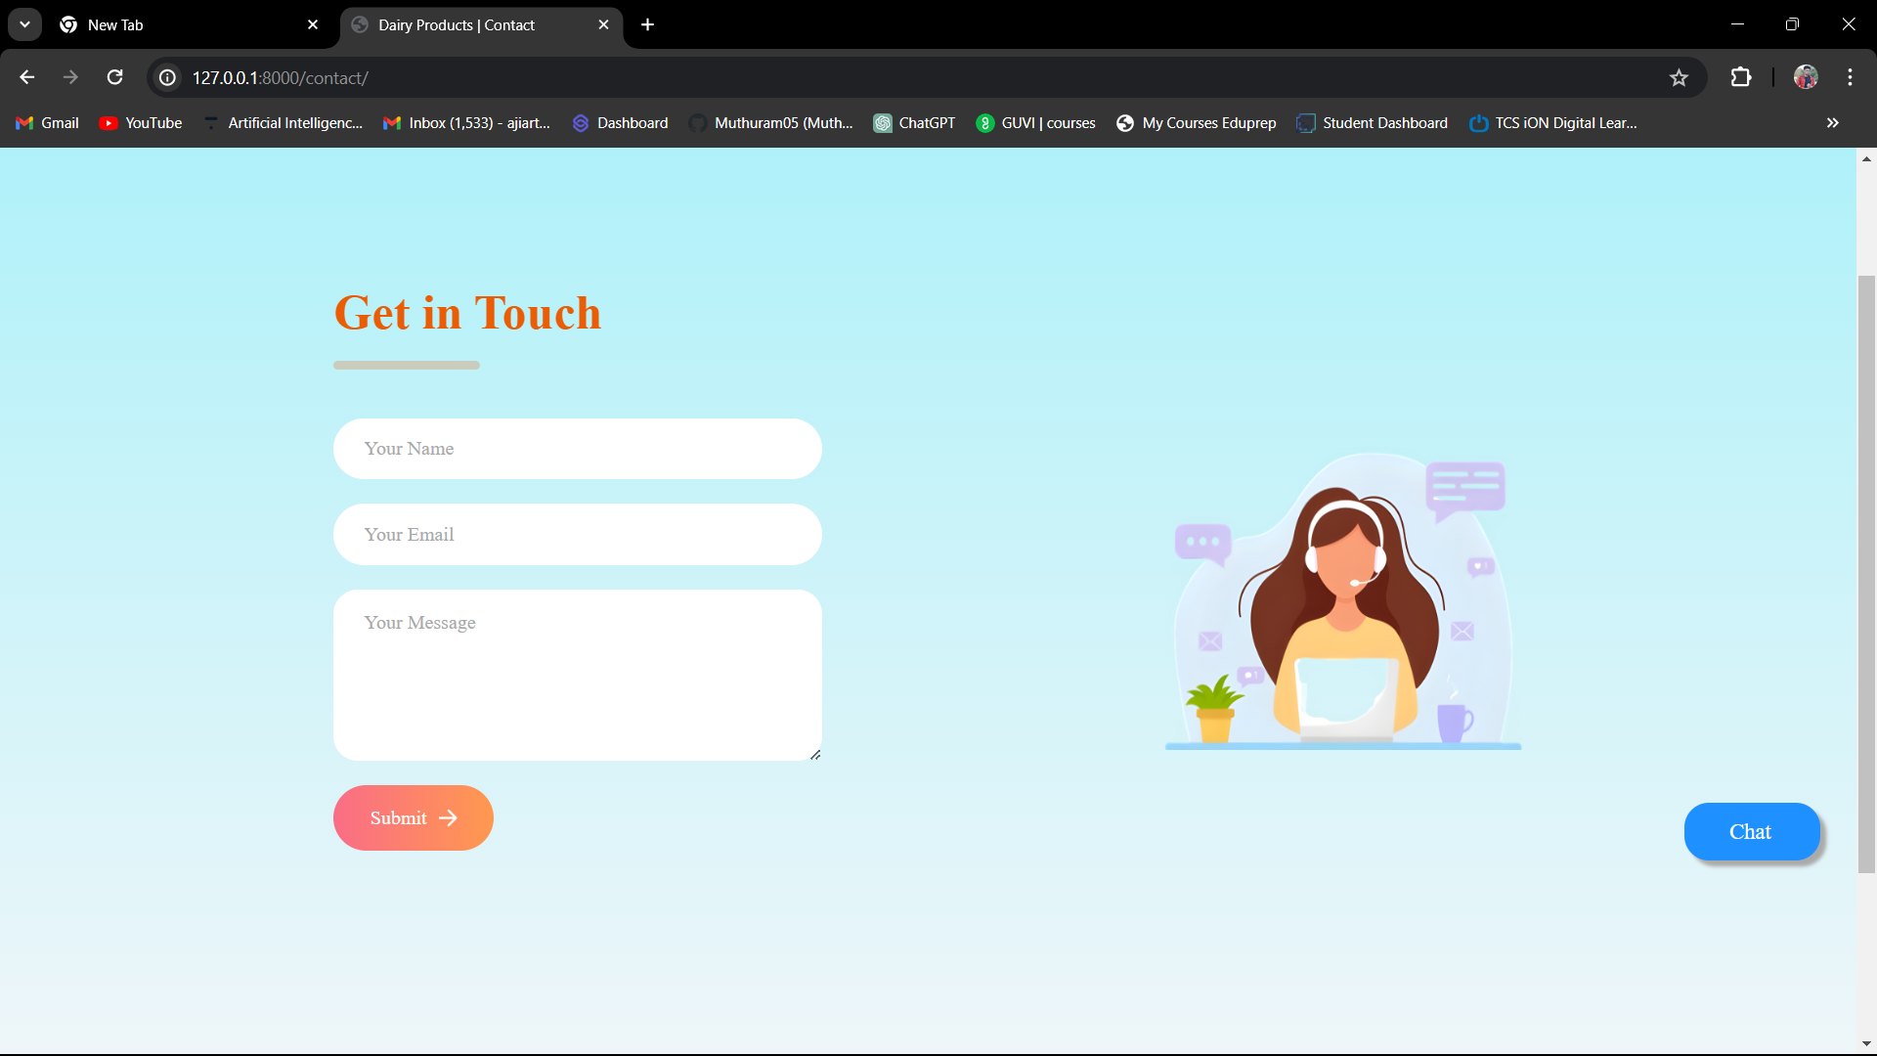
USER FEEDBACK AND REPORTING MODULE
Facilitate user engagement and system improvement through feedback collection and reporting mechanisms.

Slide 12
CONCLUSION
The “Park Spot Detection” system represents a major step forward in urban parking management only in malls. With its AI-driven approach and real-time updates, it improves parking efficiency and user experience. Moving forward, integrating with smart city initiatives and enhancing security and multi-modal support will further advance urban mobility for more sustainable and efficient malls in the cities.

Slide 13


FUTURE ENHANCEMENT
Smart City Integration: Connect with broader urban initiatives for better city-wide mobility solutions.
Enhanced Security: Use license plate recognition and tracking for safer parking areas.
Navigation Integration: Link with GPS apps for instant parking availability and easy navigation.
Multi-Modal Support: Extend to include bike-sharing, electric vehicle charging, and ride-sharing for diverse transportation options.

Slide 14


THANK YOU

Slide 15

ANY QUERIES

